Slide 1
Shiny Happy People Sharing Geospatial Data
Bobby Sayers and Melissa Albino Hegeman

Slide 2
Disclaimer
The opinions represented here are our own and do not reflect NYS policy.

Slide 3
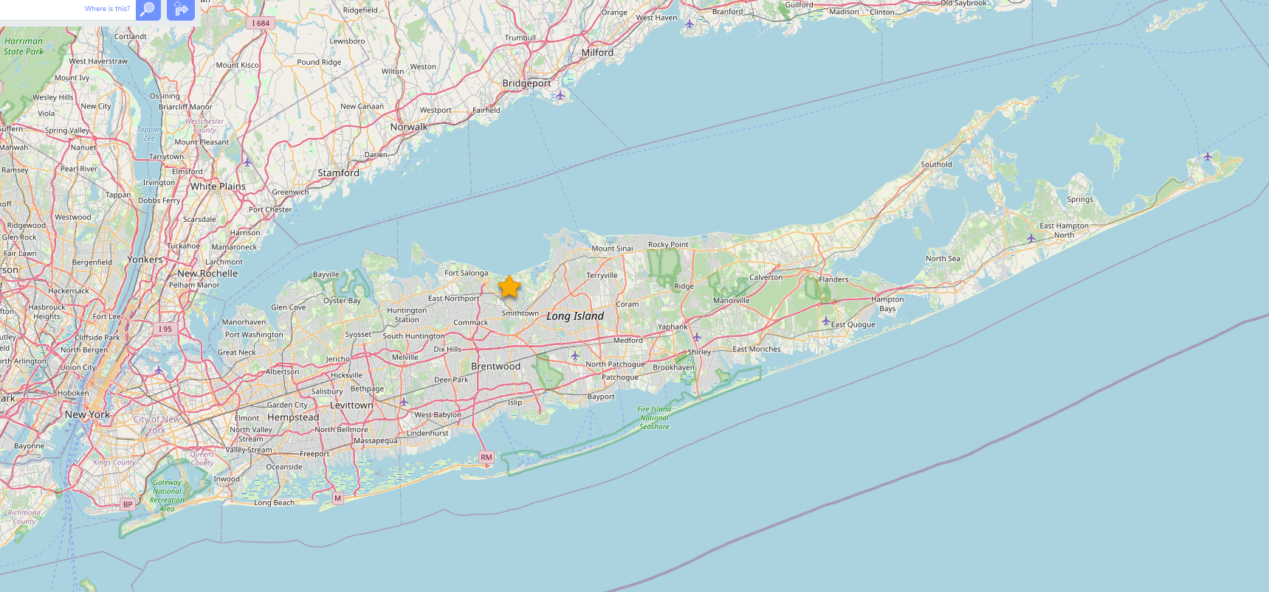
Who we are
Melissa Albino Hegeman
Bobby Sayers
Map nerds
Marine Biology/Fisheries Management
Esri users
R/Python/SQL users
Notes:
Who are we and why should you listen to us?
Melissa: I am the fisheries data manager and I work with trip level commercial fishing data. I am also the GIS coordinator for the Division of Marine Resources. I’ve been using SQL, R, and ESRI products for ….
Bobby: I am the Environmental Program Specialist in Marine Resources. Provide support for GIS to the division. Using R, Python and ESRI tools.

Slide 4
Overview
Challenges and limitations of viewing spatial data with your coworkers
Potential solutions using open-source software to create custom apps
App demo
Summary and questions

Slide 5
Some Common Roadblocks
Expensive servers and hosting solutions 💰
Proprietary software 💾
Complex installation processes 🧩
Ongoing maintenance 🛠
Notes:
Melissa:
As data analysists we help programs get answers from their data. We get all sorts of questions and use all types of data, but geospatial data has been a real sticking point lately. Certain geospatial tasks are just standard now, people don’t even know it is GIS. Things like Google Maps have set peoples expectations pretty high. People want to zoom, pan, compare different data sets, click on maps for more information, etc. There is an expectation of interactivity. Traditionally that type of functionality has required more enterprise level tools and/or software, or a server to host the app. More resources than an average individual or small office may have available.

Slide 6

Notes:
Melissa: In the past we’ve used locally running Shiny Apps to address these problems, but that requires the user to have R running on their computer and maintain that installation as well as the repository the has the Shiny App.

Slide 7
Web application framework
Available in both R and Python
Notes:
Melissa: Shiny is a web application framework that allows you to create interactive web applications directly from R or Python. It is a great tool for creating interactive data visualizations and dashboards.
Is anyone currently using Shiny? For R or Python?

Slide 8


Web application framework
Available in both R and Python
Notes:
Melissa: In the last few years we’ve started hearing about WebR and Pyodide. These technologies allow people to use R and Python in the browser - no installation required.

Slide 9
Web Assembly
Enables code written in other languages to run in web browsers
Allows near-native performance
Runs in a secure sandbox
Permits R and Python applications to run without a server
Notes:
We aren’t going to get into the weeds too much, but for the purposes of this presentation it allows us to run R and Python in the browser. It is fast and secure.
If you are old enough to remember Adobe Flash games it is a similar idea, but secure.

Slide 10
The Challenge
Make an interactive map 🗺
Compare two data sources 💻
Keep it private 🔏
Keep it consistent ✅
Notes:
Bobby: We decided to create a challenge for ourselves to see if webR and Pyodide could address some of our issues. Our goal was to create a basic, light-weight interactive map that anyone can use without installing anything.

Slide 11
Free and Open-Source Options
Prioritized free and open-source software
Reduces up front costs
Acknowledge difficulties of using free and open-source software
Lack of local IT support
Lack of technical expertise
Notes:
Bobby Our preference is always free and open-source software. This is important for cost issues, but also makes everything more repeatable. But nothing is perfect so you do need to be aware of organizational restrictions on installation, platform compatibility, and the technical expertise of the people who will be using your app. Lots of technical documentation available even though there aren’t a lot of production examples available.

Slide 12
Shinylive
Creates interactive applications
Leverages WebAssembly technology
Allows creation of lightweight, serverless apps
Supports both R and Python
Notes:
Earlier we talked about Shiny. ShinyLive is the web assembly version of shiny. It isn’t a programing language by itself, but it was converted to work with both pyodide (Python) and webR (R). Since we’ve already been using Shiny, it made sense to continue with a framework that we were familiar with.

Slide 13
Requirements
Runs entirely in the browser
Supports file uploads
Integrates with popular libraries (e.g., leaflet)
Notes:
Our proof of concept app MUST run entirely in the browser, allow file uploads, and work with libraries we are already using.

Slide 14



The App
Notes:
We were looking for a low-stakes project to make a proof of concept app. Our office as a running group that participates in Long Island Parks Summer Run Series every year. We thought it would be cool to make an app that would allow us to compare our performances year to year and see how we were improving… or not and compare our results on the same races. In a non competitive way :)
We were all using different apps to track our runs. Fortunately, all of these apps support exports using the .tcx standard. Training Center XML from Garmin and it has become the standard. GPS track, heart rate, running cadence, bike sensors, etc.

Slide 15
Demo
WebR example
Pyodide example
Notes:
We want our app to accept tcx files, plot the gps track, and graph our heart rate.
We’re going to show you some very un-aesthetic examples of the features we really wanted to implement. Again, these apps are meant to be very lightweight and potentially replace the lower level licenses that we mentioned earlier.

Slide 16
Results
Pros
Provide a consistent analytics environment
Access advanced geospatial tools through a web browser
Upload and analyze personal data securely
Collaborate easily by sharing a single URL/file
Cons
Can’t access network resources (such as a SQL server)
Dependent on internet connection to access Web Assembly components
Dependent on the speed of your local machine
Notes:
Benefits to the creators and the end users.
Everyone is using the same ‘stuff’. Trouble shooting becomes easier because everyone is using the same source and you can feelconfident that outputs are consistent. Keeps private stuff private.

Slide 17
Next Steps
Use public web feature services
Export results as pdf or table
Add additional files types (.csv, .shp, etc.)
Calculate distance or create a buffer

Slide 18
Questions?
Melissa Albino Hegeman: melissa.albino@dec.ny.gov
Bobby Sayers: robert.sayers@dec.ny.gov
Presentation slides: https://github.com/mhegeman/2024_scgis_webr

